Slide 1
Course - DT228/1 and DT282/1
Subject - Computer Architecture and Technology
REVISION
Semester 2, Week 12

Slide 2
Exam Date and Time
The exam date for this module that I (Art) have been notified about is:
Friday 19th May 2017
4.00 – 6.00pm
Venue to be arranged

Slide 3
‘Steering a Course’ Through the Module
For the subsequent slides, we can take a look at samples of topics and subtopics that marked specific and interesting aspects of Computer Architecture and Technology…

Slide 4
Computer System
A computer system can be described as having
input(s),
procedure(s) or process(es),
output(s).
INPUT ------→ PROCESS -----→ OUTPUT
A computer system is a set of hardware and software that processes data.
A relatively simple computer system is a personal computer. An example of a complex computer system is the Internet.

Slide 5
Von Neumann Architecture
In a special purpose machine the computational procedure could be part of the hardware. In a general purpose one the instructions must be as changeable as the numbers they acted upon.
To von Neumann the key to building a general purpose computing machine was in its ability to store not only its data and the intermediate results of computation, but also to store the instructions, or orders that allowed the computation. Encode the instructions into numeric form and store instructions and data in the same memory is frequently viewed as the principal contribution provided by von Neumann's insight into the nature of what a computer should be.

Slide 6
The Architecture (2)
The stored program concept had several technical implications:
Four key sub-components operate together to make the stored program concept work.
The process that moves information through the sub-components is called the ‘Fetch-Execute Cycle’.
Unless otherwise indicated, program instructions are executed in sequential order.

Slide 7
Energy for Computers
A computer functions on electricity and magnetism. The magnetism is very often a product of electrical flow.
There is a great deal of light and reflection in modern hardware (lasers and fibre optics) but light is a medium generated by electrical flow.
Electricity in a computer circuit has voltages (DC - direct current):
@ +12 Volt for a disk drive,
@ + or -5 Volt or + or -3 Volt for buses and communications wiring,
@ 1.7, 1.5 or 1.3 Volt for the processor.
R - 7
Notes:
7

Slide 8
Energy for Computers (2)
Whatever the voltage the flow can be switched on and off - or be present or absent.
Voltage on might equal a 1,
Voltage off might equal a 0. Binary!
All information (instructions, data, etc.) flows through the hardware system as 'Power On' or 'Power Off‘ - as 1s and 0s.
R - 8
Notes:
8

Slide 9
Information Types
Five types of information that the computer commonly manipulates:
Numeric
Character
Visual
Audio
Instructional
First, the information must be transformed (converted) into an acceptable representation that the computer will accept.

Slide 10
Central Processing Unit
The central component in the von Neumann Architecture is called the Arithmetic Logic Unit.
This is the subcomponent that performs the arithmetic and logic operations based on combinations of flip-flops, latches and gates, generally.
The ALU is the “brain” of the computer.
The ALU contains many of the registers.
Its flip-flop and latch circuitry allows it to perform addition, subtraction, multiplication and division, as well as logical comparisons: less than, equal to and greater than.

Slide 11
Control Unit, Registers
The control unit drives the fetch and execute cycle. In memory, a cell address is loaded into the MAR – it is the control unit that figures out which address is loaded, and what operation is to be performed with the data moved to the memory data register (or machine data register) - MDR.
To do its job, the Control Unit has several tools such as special memory registers – a ‘hard-wired’ understanding of an Instruction Set. The Control Unit must keep track of where it is within a program, and what it should do next
Two special registers are used to accomplish this:
A program counter, typically referred to as a PC, holds the address of the next instruction to be executed.
An instruction register, typically referred to as an IR, holds an instruction fetched from memory.

Slide 12
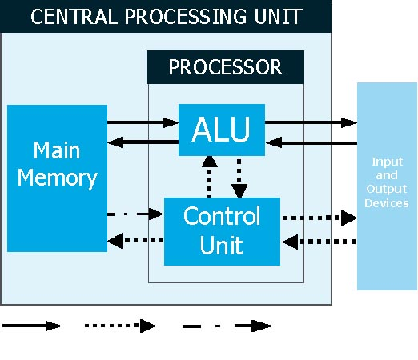
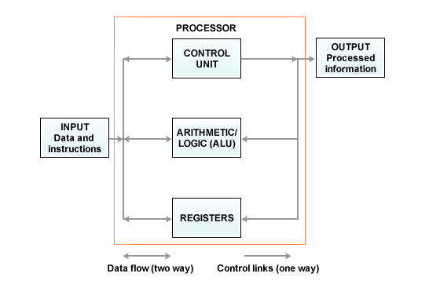
Control Unit (Layout)

Slide 13
Personal Computer Buses
There are a number of types of buses, including the following:
Processor bus
Address bus
Memory bus
System – or I/O bus (Input/Output bus)
Processor Bus + Memory Bus + Data Bus = System Bus

Slide 14
Processor Bus
The processor bus is the communication pathway between the CPU and immediate chipsets.
This bus is used to transfer data between the CPU and the main system bus, for example, or between the CPU and an external memory cache.
The processor bus is required:
to get information to/from the CPU at fastest possible speed -
so this bus operates at a much faster rate than any other bus on a PC.
The processor bus consists of electrical circuits for data, for addresses (the address bus), and for control purposes. The same ‘control’ as the CPU’s Control Unit.

Slide 15
Expansion and Connectable Devices
Expansion slots allow devices to be added to a computer. The connector has a series of connection pinholes; depending on the need of the device card, they may have 16 to 64 closely-spaced holes to connect to the motherboard. The slot itself is a place to fit an expansion card containing the circuitry that provides a particular capability.The I/O bus or expansion slots:
They enable a CPU to communicate with, or add peripheral devices to, your computer to expand its capabilities.
Devices such as:
sound cards,
video cards,
network interface cards,
(Small Computer System Interface) SCSI host adapters
Universal Serial Bus and others can be plugged into expansion slots.

Slide 16
Hardware / Software
‘Hardware’ is the term that encapsulates the electronic devices and circuitry that make up the physical components of the computer system. These elements are the computer parts that you can see and touch. Elements such as:
Central Processing Unit (CPU),
Primary storage,
Secondary storage,
Input devices,
Output devices and
Communications devices

Slide 17
Hardware / Software (2)
‘Software’ is the term that describes the instructions (and data) that determine the use of the processing capability.
Software is often the invisible means of process that goes on as the computer is running. Hardware and software together encapsulate a working computer system. This allows a datum (singular) and data (a collection of datum) to be represented for input, processing and/or output.
Examples of non-physical elements – (Software):
Systems software and/or Operating Systems (O/S),
Applications software,
Database Management Systems (DBMS). (Optional for most computer systems.)
Communications software (when connected to a network)

Slide 18
Internal Hardware
Inside the ‘box’ there are devices and components that make up the communication subsystem, the storage subsystem and the processing system.
For the processing system there are components that are internal – i.e. close to or part of the processing capability of a typical personal computer. (3 marks)
Some hardware system components (usually electronic), on the motherboard:
CPU – Central Processing Unit
BIOS – Basic Input/Output System
RAM – Random Access Memory

Slide 19
Digital Circuits
A digital circuit is constructed of a power supply, devices, and conduction nets. Some nets provide circuit inputs from the “outside world”; in a schematic, these input nets are generally shown entering the left side of component and/or the overall circuit. Other nets present circuit outputs to the outside world; these nets are generally shown exiting the schematic on the right.
A digital circuit requires a power supply to provide a constant and stable source of electric power to all devices, providig a local, contained imbalance of electrons that provides a voltage source. Example; transmitting information through a conductor from one device to another.
As electrons flow to and from the devices in a given circuit, they can change device properties in useful ways.

Slide 20
Digital Circuits (2)
Electronic circuit components:
Resistors
Capacitors
Input Devices
Output Devices
Connectors
Printed Circuit Boards
Integrated Circuits

Slide 21
Operating System
When you switch on your personal computer (PC) you will often see a black screen with prompts that scroll and disappear as the machine prepares for the operating system. These are startup routines that are, essentially, instructions to the hardware system to find and run other instruction files that motivate the operating systems.
When a system is up and running – i.e. after bootup – the Operating System has been loaded, usually, as part of the startup routine.
At the lowest level an Operating System has a supervisor – the Kernel.
The Kernel is the essential centre of a computer operating system, the core that provides basic services for all other parts of the operating system.

Slide 22
Operating System (2)
A Kernel can be contrasted with a shell, the outermost part of an operating system that interacts with user commands.
On the next level (above the Kernel) are Control Programs:
Command analyser
Resource scheduler
Priority control
On the next level (above Control Programs) are Utility Programs:
Support routines
Program development and maintenance utilities

Slide 23
Numbers and Number Bases
Numbers are often represented in decimal form for our mathematical use. This is the 'Base 10' number system and it is the number format that we, as humans, might feel most comfortable with.
Computing machines operate on electrical current and so use two states. We view these states as the numbers 0 and 1. This is the binary representation and is called 'Base 2'. Each is called a ‘bit’, short for 'binary digit‘.

Slide 24
Binary Numbers
Computing machines operate on electrical current and so use two states. We view these states as the numbers 0 and 1. Each is called a ‘bit’, short for 'binary digit‘. This is the binary representation and is called 'Base 2'.
The fact that data are represented in binary allows a computer to convert numbers, as data elements, by the mathematical operations of programmed addition, subtraction, multiplication and division.
Negative numbers are represented, in binary, by Two's Complement.

Slide 25
Octal and Hex Numbers
Octal and hexadecimal data types are integer types that are available in most computer languages.
Long binary digit sequences that represent large decimal numbers are difficult for us to deal with.
The Octal notation for representing Binary numbers uses groups of three bits:
Suppose that we group the binary digits into fours. In Hex symbols chosen are the common numerals (0 - 9) and the remaining six possible four-bit combinations are represented by the letters, A, B, C, D, E and F.
Hex example:

Slide 26
Logic Gates
Boole applied algebraic techniques to the logic processes for two-value systems.
He contended that any logical statement could be assigned a binary value, such as "true/false" or "yes/no.“
Boole discussed ways of reducing logical relationships to simple statements of equality, inequality, inclusion, and exclusion.
He then showed ways to express these statements symbolically using a binary (two-valued) code.
The binary language used in today's computers reflects Boole's binary logic.
Modern computers operate solely on the binary numbers "1" and "0."

Slide 27
Logic Gates (2)
Binary digits (or logical variables) are processed in the machine as distinct voltage states in tiny electronic circuits known as logic gates.
A logic gate only recognizes two varieties of input, high-voltage (value of 1 or TRUE) and low-voltage (value of 0 or FALSE).
The truth variables of Boolean algebra use the functionality of the logical concepts of AND, OR and NOT.
The logic gates (as electronic mechanisms) are AND, OR, and NOT.
These gates, used in differing combinations, allow the computer to execute all its operations and/or store its data.

Slide 28
Memory
There are several different types of memory at processor level:
RAM (Random Access Memory)
ROM (Read Only Memory)
Registers
Cache

Slide 29
Memory Types
Cache memory is Random Access Memory (RAM) that a computer CPU can access more quickly than it can access 'main memory' RAM. As the microprocessor processes data, it looks first in the cache memory and if it finds data there, where it was placed from a previous reading of data, the CPU saves time in not having to transfer data from RAM. RAM is an array of cells, each with a unique address.
It should take the same amount of time to access any memory cell, regardless of its location with the memory bank. (‘Random’ access.)
ROM memory cells can be read from, but not written to. Cells are protected. ROM is more expensive than RAM and only critical information is stored. (i.e. Firmware instructions.)

Slide 30
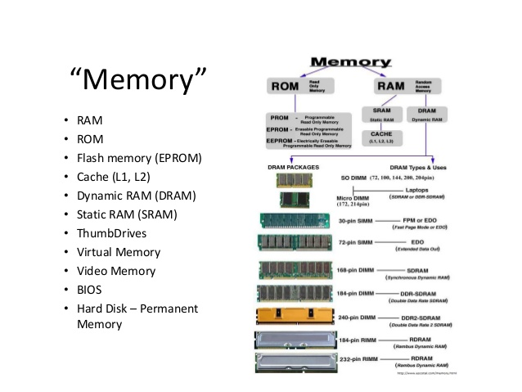
Memory Types (2)

Slide 31
Input and Output Devices
Any device that allows signals (usually binary) to affect the computer can be categorised as an input device. Obvious examples are the keyboard and the mouse.
The keyboard is the most common input device. It is the primary input device. It is used for entering commands and data into many computing systems.
Two output device examples: monitors and printers. The monitor that shows a user what is going on with a computer. It might look flat in which case it is a Liquid Crystal Display (LCD) or a Thin Film Transistor (TFT) display. A printer is a device that accepts text and graphic output from a computer and transfers the information to paper, card, plastic or photo-sensitive paper.

Slide 32
Multi Core Processors
Place two or more processor circuits on one IC (integrated circuit) – or two or more individual processors to work together - and you have a ‘multicore’ (or multi-core) architecture. A core is a collection of one or more processor threads with the components to execute instructions – such as Arithmetic Logic Unit, Cache, RAM…
Multi core arrangements usually contain much more cache than regular processors.
A thread (thread of execution) is ‘placeholder information’ associated with a single use of a program that can handle multiple concurrent users. A thread is like a task but is not actually an instruction task. Many ordinary, single-core processors can perform ‘multithreading’ - multiple threads are executed in parallel by ‘time slicing’ the processing capability of the processor and the processor can function by switching between different thread.

Slide 33
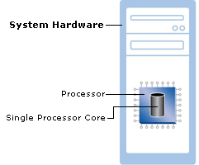
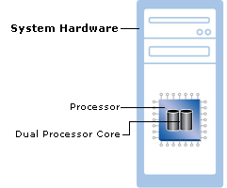
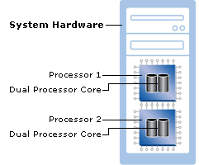
Multi Core Processors (2)
Microsoft’s multi-core diagrams:
1
2
3

Slide 34
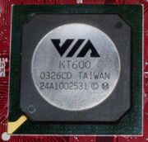
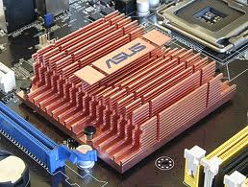
Northbridge
The name is derived from drawing the architecture in the fashion of a map. The CPU would be at the top of the map at due north. The CPU would be connected to the chipset via a fast bridge (the northbridge) located north of other system devices as drawn. The northbridge would then be connected to the rest of the chipset via a slow bridge (the southbridge) located south of other system devices as drawn.
A northbridge typically will only work with one or two different southbridge ASICs (Application-Specific Integrated Circuit); in this respect, it affects some of the other features that a given system can have by limiting which technologies are available on its southbridge partner.

Slide 35
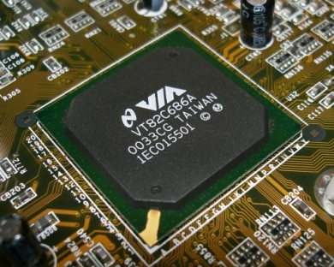
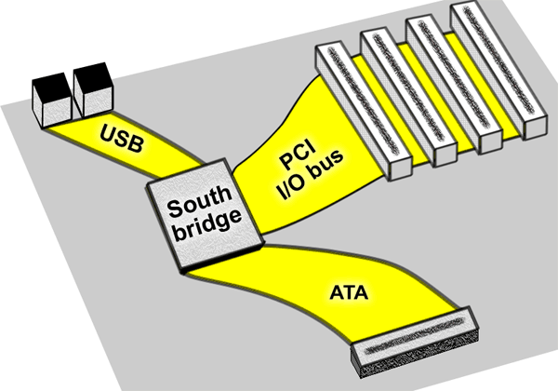
Southbridge
Connecting the southbridge During the Pentium era chipset designers avoided bottlenecks in motherboard designs. As peripheral connections became more sophisticated it became obvious that the PCI bus could no longer be used to connect the north and southbridge chips. The PCI was not efficient enough. Improvements in device speeds of internal and external devices created larger bandwidth requirements for the connection between north and southbridges.
An increased number of devices was attached to the southbridge. It is easy to see that using the PCI bus as a chipset interconnect can be a system bottleneck.

Slide 36
Client Server Networks
Client-Server describes the relationship between two computer programs where one program, the client, makes a service request from another program, the server, which fulfills the request. Although the client-server idea can be used by programs within a single computer, it is more often associated with networks.
A client/server system includes one or more servers to store programs and/or data in a central location.
Users (clients) access the programs or data when their software request to the server, across the network, is dealt with. The client-server model provides a convenient way to interconnect programs and data that are distributed efficiently across different locations

Slide 37
Protocol
To communicate with each other, two machines must follow the same protocol.
A protocol is the special set of rules that end-points in a telecommunication connection, such as two PCs on a Local Area Network, use when they communicate. They are, essentially, a type of system software.
Looking at a typical protocol as a file transfer and management tool one might see these features:
File group transmission,
File attribute transmission (size, date, permissions, etc)
File name, record-format, and character-set conversion,
File collision options,
/… continued

Slide 38
File transfer recovery,
Auto upload and download (of data or files)
Client/Server operations,
Automatic per-file text/binary mode switching,
Recursive directory-tree transfer,
Uniform services on serial and network connections,
An Internet service daemon.

Slide 39
Network Transmission Media
Network transmission media generally fall into one of the following groups:
Copper wire - carries electrical signals, much like telephone or cable TV wiring.
Optical fibre - carries light-waves, either from lasers or Light Emitting Diodes.
Wireless - radio signals or infra-red light pulses
Each medium has its own advantages and disadvantages .

Slide 40


Coaxial and Fibre-Optic Cable
Coaxial cabling has a single copper conductor at its centre, a plastic layer provides insulation between the centre conductor and a braided metal shield. The metal shield helps to block any outside interference from fluorescent lights, motors and other computers.
Fibre optic cable is used when high speed networking is required. Example: live video feed through networked computers with high-specification graphics processing
Fig. 1. Coaxial cable
Fig. 2. Fibre optic cable

Slide 41
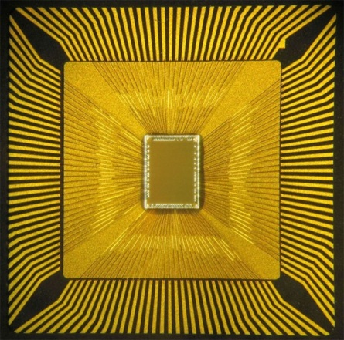
IBM TrueNorth
Research published in Journal Science
Consists of electronic “Neurons”
It attempts to mimic the way brain recognises patterns
Works parallely
Would be able to recognise that a person in a video is picking up an identifiable object or control a robot that is reaching into a pocket and pulling out a coin. (Humans can do this without any ‘conscious’ effort.)
5.4 billion transistors (only 70 milliwatts of power)
In contrast, an Intel processor has 1.4 billion processors and require 35 - 140 watts!!
One million neurons – about as complex as the brain of a bee

Slide 42
SyNAPSE
Defense Advanced Research Projects Agency (DARPA) to re-create the human brain's perception, cognitive, sensation, interaction, and action abilities.
DARPA's Systems of Neuromorphic Adaptive Plastic Scalable Electronics (SyNAPSE) project:
to create a system that not only analyses complex information from multiple sensory modalities at once, but also dynamically rewires itself as it interacts with its environment
Digital silicon circuits inspired by neurobiology to make up what is referred to as a 'neurosynaptic core' with integrated memory (replicated synapses), computation (replicated neurons), and communication (replicated axons).

Slide 43

The End
That’s it for Computer Architecture and Technology.
GOOD LUCK in the exam!!

